Slide 1
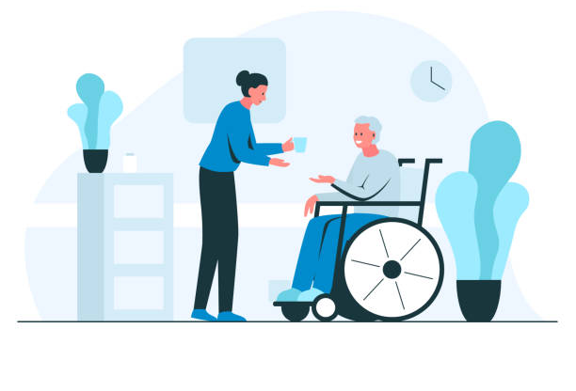
Assistive technology for elderly people in the context of Finland
Dilsha Weliwita
12195171

Slide 2

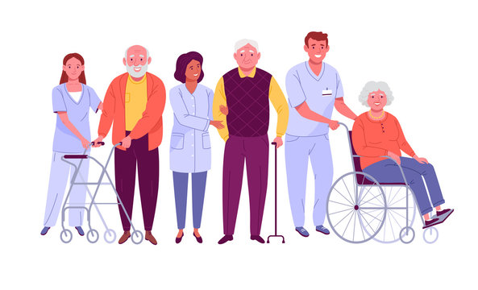


Assistive Technologies
Includes IT devices & systems
Assists the elderly & individuals with disabilities
Helps with mobility, safety & daily schedules

Slide 3






Types of Assistive Technology
Vision
Hearing
Speech
Cognition
Mobility
Daily Living

Slide 4




Emerging Assistive Technologies
Virtual Reality (VR) Goggles
Smart Pill Bottles and Boxes
Wireless Monitoring Devices
Fall Detection Watches

Slide 5


Benefits of Assistive Technologies
Reduces work of caregivers
Reduces the impact of disease and disability
Promote well-being
Helps people to live healthy, satisfying and independent lives

Slide 6





Gestures Used
1
2
3
4
5
Hello
Clenched Fist
Measurer
Thumbs Up
Precision grip

Slide 7
Thank You!
Any Questions?
Video Link:
https://cqu365-my.sharepoint.com/:v:/g/personal/12195171_cqumail_com/EYxFwj0HX0BOgscazcbLBVkBBOkoj4viD8zCUhAuHqwUJg

